Slide 1
COMP 3100
Week 12 - Wednesday

Slide 2

Last time
What did we talk about last time?
Financial and economic planning
  Time value of money
  $F_{n}=P⋅{\left(1+r\right)}^{n}$

Slide 3
Questions?

Slide 4
Project 4

Slide 5
Finishing Financial Planning

Slide 6
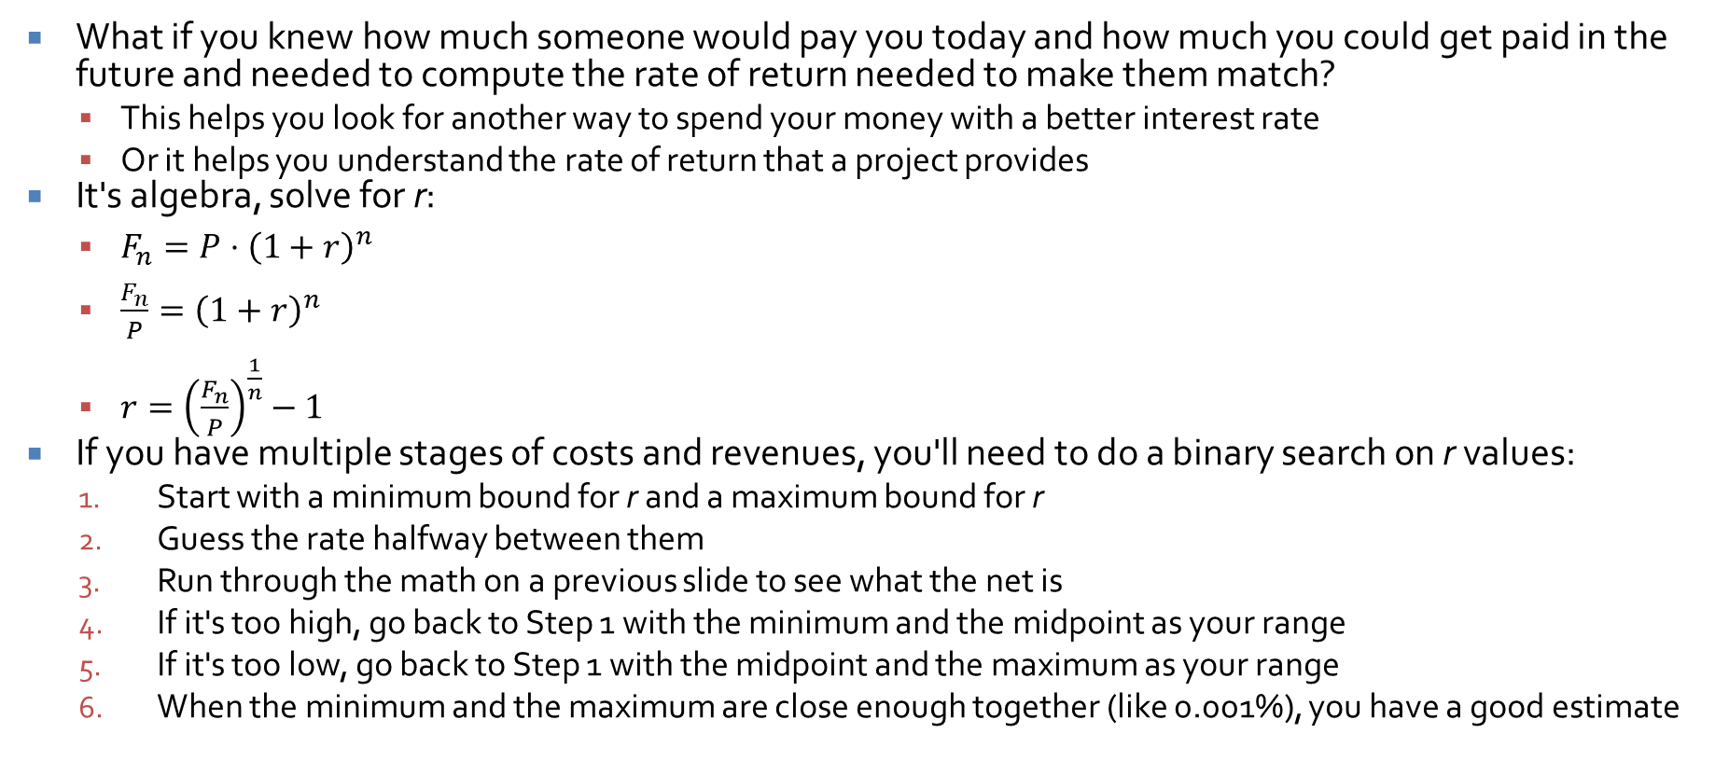
Internal rate of return
What if you knew how much someone would pay you today and how much you could get paid in the future and needed to compute the rate of return needed to make them match?
  This helps you look for another way to spend your money with a better interest rate
  Or it helps you understand the rate of return that a project provides
It's algebra, solve for r:
  $F_{n}=P⋅{\left(1+r\right)}^{n}$
  $\frac{F_{n}}{P}={\left(1+r\right)}^{n}$
  $r={\left(\frac{F_{n}}{P}\right)}^{\frac{1}{n}}−1$
If you have multiple stages of costs and revenues, you'll need to do a binary search on r values:
  Start with a minimum bound for r and a maximum bound for r
  Guess the rate halfway between them
  Run through the math on a previous slide to see what the net is
  If it's too high, go back to Step 1 with the minimum and the midpoint as your range
  If it's too low, go back to Step 1 with the midpoint and the maximum as your range
  When the minimum and the maximum are close enough together (like 0.001%), you have a good estimate

Slide 7
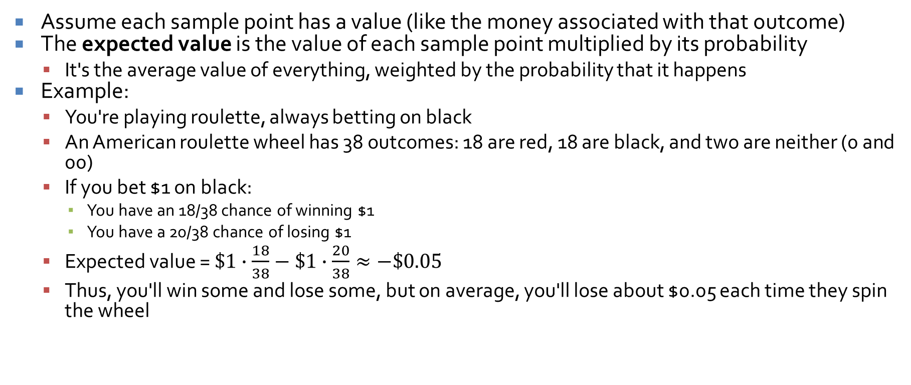
Expected value
Assume each sample point has a value (like the money associated with that outcome)
The expected value is the value of each sample point multiplied by its probability
  It's the average value of everything, weighted by the probability that it happens
Example:
  You're playing roulette, always betting on black
  An American roulette wheel has 38 outcomes: 18 are red, 18 are black, and two are neither (0 and 00)
  If you bet $1 on black:
    You have an 18/38 chance of winning $1
    You have a 20/38 chance of losing $1
  Expected value = $\$1∙\frac{18}{38}−\$1∙\frac{20}{38}≈−\$0.05$
  Thus, you'll win some and lose some, but on average, you'll lose about $0.05 each time they spin the wheel

Slide 8
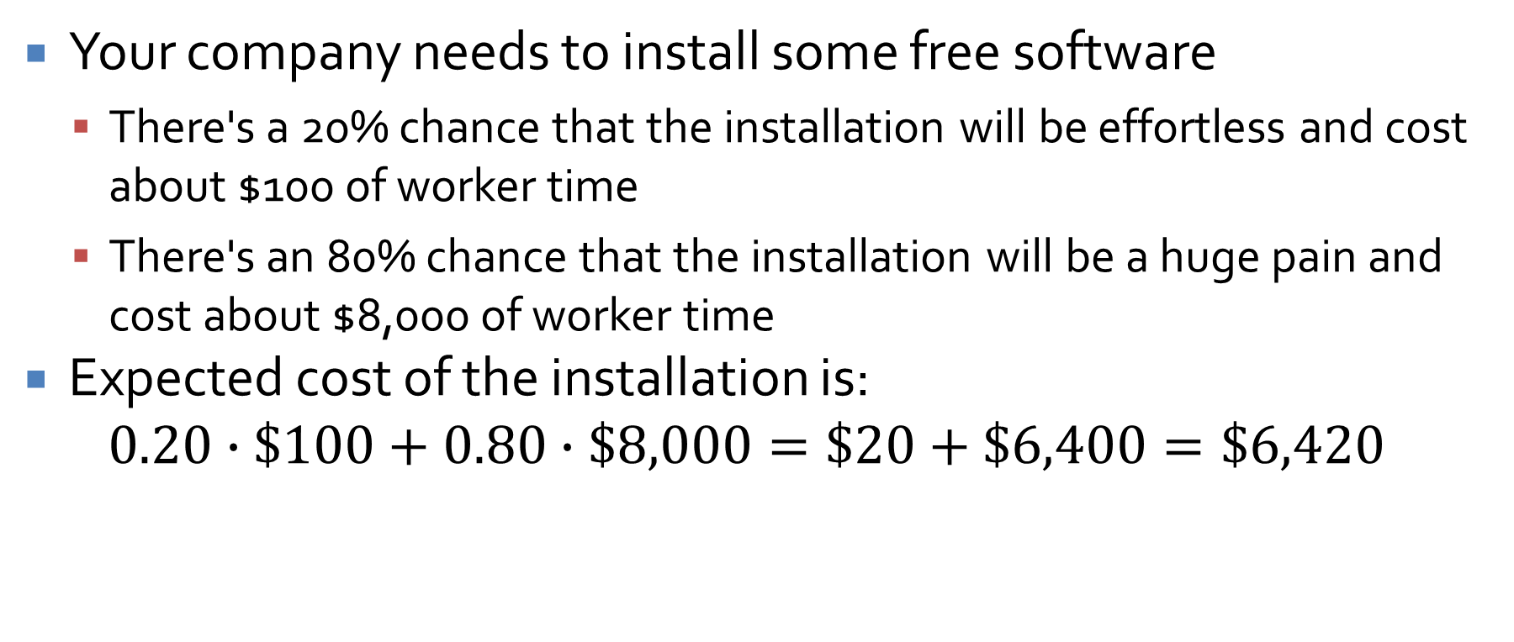
Simple example with uncertainty
Your company needs to install some free software
  There's a 20% chance that the installation will be effortless and cost about $100 of worker time
  There's an 80% chance that the installation will be a huge pain and cost about $8,000 of worker time
Expected cost of the installation is:
$$0.20∙\$100+0.80∙\$8,000=\$20+\$6,400=\$6,420$$

Slide 9
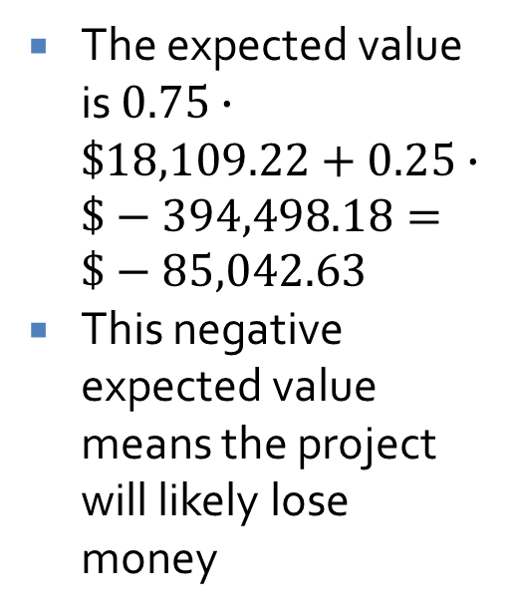
Complex example with uncertainty
We can take the go-no go example and add probability to it
We'll say that there's a 25% chance that the customer goes broke after three years, ending the revenue we'd get (and also the costs)
The table showing this outcome looks like this:
The expected value is $0.75∙\$18,109.22+0.25∙\$−394,498.18=\$−85,042.63$
This negative expected value means the project will likely lose money
n | R | C | (1 + r)^{n} | R / (1 + r)^{n} | C / (1 + r)^{n} | Net
0 | 0.00 | -450000.00 | 1.0 | 0.00 | -450000.00 | -450000.00
1 | 100000.00 | -80000.00 | 1.04 | 96153.85 | -76923.08 | 19230.77
2 | 100000.00 | -80000.00 | 1.0816 | 92455.62 | -73964.50 | 18491.12
3 | 100000.00 | -80000.00 | 1.124864 | 88899.64 | -71119.71 | 17779.93
4 | 0.00 |  | 1.16985856 | 0.00 | 0.00 | 0.00
5 | 0.00 |  | 1.2166529024 | 0.00 | 0.00 | 0.00
 |  |  |  | 277509.11 | -672007.29 | -394498.18

Slide 10
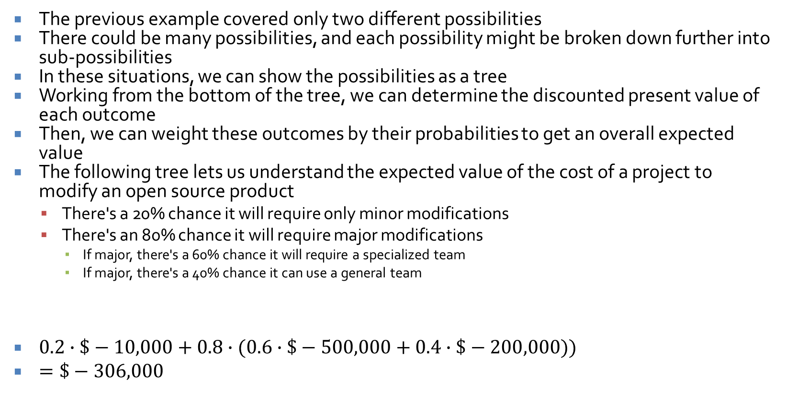
Probability trees
The previous example covered only two different possibilities
There could be many possibilities, and each possibility might be broken down further into sub-possibilities
In these situations, we can show the possibilities as a tree
Working from the bottom of the tree, we can determine the discounted present value of each outcome
Then, we can weight these outcomes by their probabilities to get an overall expected value
The following tree lets us understand the expected value of the cost of a project to modify an open source product
  There's a 20% chance it will require only minor modifications
  There's an 80% chance it will require major modifications
    If major, there's a 60% chance it will require a specialized team
    If major, there's a 40% chance it can use a general team
$0.2∙\$−10,000+0.8∙(0.6∙\$−500,000+0.4∙\$−200,000))$
$=\$−306,000$

Slide 11
Scheduling

Slide 12
Scheduling
Two weeks ago, we talked about effort estimation
Effort estimation predicts the number of person-months needed to do a project
Even if we had a perfect estimate of the amount of work to be done, we would still have to take many things into account to predict when the project will be done
  How many people
  Details of tasks
  Task dependencies
  Personnel capabilities

Slide 13
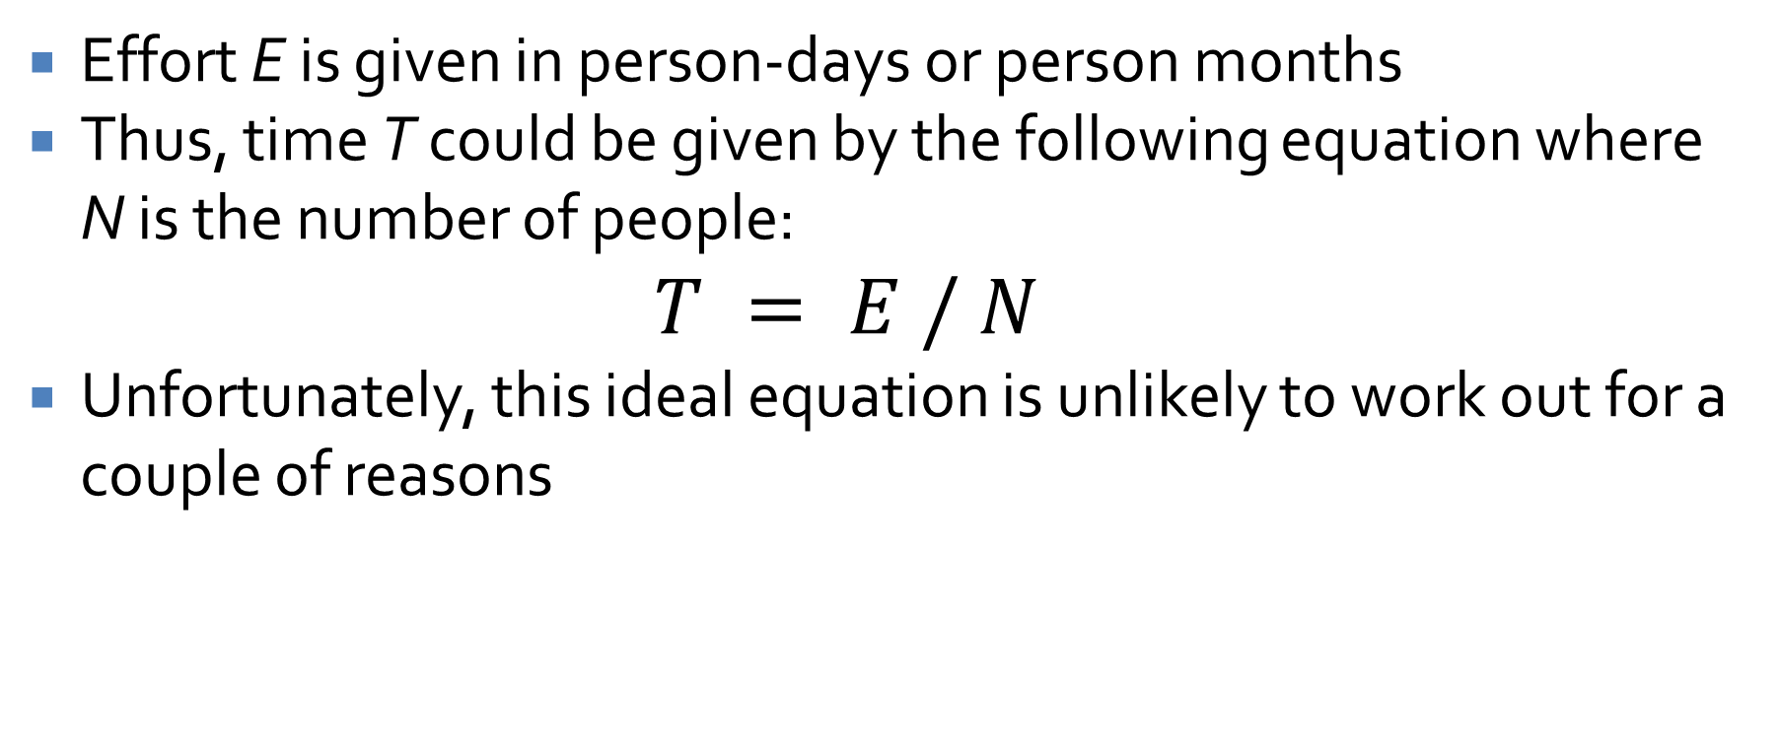
People
Effort E is given in person-days or person months
Thus, time T could be given by the following equation where N is the number of people:
  $$T = E / N$$
Unfortunately, this ideal equation is unlikely to work out for a couple of reasons

Slide 14
Details of tasks
Some tasks are easy to split up, and others are not
If it takes 5 minutes to pump up a bicycle tire, you can't do it 100 times faster by using 100 people instead of one
Small tasks can usually only be done by a single person at a time
Larger tasks generally obey the T = E / N rule, but there are diminishing returns for large values of N

Slide 15
Task dependencies
Looking at the time to do individual tasks isn't enough
Consider tasks A, B, and C with the following amounts of effort:
  A: 5 person-months
  B: 3 person-months
  C: 4 person-months
If we have three employees, one can work on each task
If the tasks are independent, the project will take 5 months to do, and tasks B and C can even run late without delaying the total project
What if C requires B to be done and B requires A to be done?
  If any task is delayed, the whole project will be delayed
  We have to share work on each task

Slide 16
Personnel capabilities
Some developers are better than others
  This messes with the overall T = E / N rule
Some developers have specialized in certain areas
  A tester might be great at testing but not so good at development
  Only one person on the team might have experience with GUIs
As a consequence, it might not be possible to have multiple people working on a given task, and one person might be needed for two different tasks
Agile methodologies supposedly improve these issues by trying to make everyone work on everything and grow their skills

Slide 17
Simplifying assumptions
We assume that we have a good estimate of the relationship between effort and time
We assume small tasks assigned to one person
We assume a dependency between two tasks if only one person has the skills needed to do both
  This allows us to look at the problem of specific skillsets as the more general problem of dependencies
With these assumptions, we can organize our tasks by duration and dependency

Slide 18
Dependency example
Task Number | Duration (Days) | Prerequisite Tasks
1 | 6 | -
2 | 5 | 1
3 | 2 | 1
4 | 6 | 1
5 | 4 | 2, 3
6 | 1 | 4
7 | 2 | 4
8 | 4 | 4
9 | 3 | 2
10 | 4 | 5, 6
11 | 1 | 7, 8
12 | 4 | 9, 10
13 | 2 | 6, 11
14 | 1 | 12, 13
The following example shows 14 tasks
The time for each task is given
The prerequisite tasks that must be done first are listed too
Tasks are numbered so that higher number tasks are dependent on lower number tasks

Slide 19
Another view of the same tasks
Task Number | Subsequent Tasks
1 | 2, 3, 4
2 | 5, 9
3 | 5
4 | 6, 7, 8
5 | 10
6 | 10, 13
7 | 11
8 | 11
9 | 12
10 | 12
11 | 13
12 | 14
13 | 14
14 | -
The previous slide has all the information we need
But it's not displayed in a way that is helpful for every kind of analysis
For example, it's hard to figure out how long the whole project will take
It's also hard to identify critical tasks, the ones that determine the minimum time for the project
Another thing we want to see is slack (or float), the amount of time non-critical tasks can slip without delaying the project
To the right is another view that shows which tasks are dependent on a given task

Slide 20
Gantt charts
Gantt charts let us find total time, critical tasks, and float times
  Tasks are represented as rectangles with length proportional to duration
  Dependencies between tasks are arrows
  Time increases from left to right
  We put the task starts as early as possible, immediately after their last prerequisite finishes

Slide 21
Partial Gantt chart example
The first five tasks from our earlier table have the following characteristics
Corresponding Gantt chart:
0 5 10 15 20 25
Time
1
2
3
4
5
Task | Duration | Prerequisites
1 | 6 | -
2 | 5 | 1
3 | 2 | 1
4 | 6 | 1
5 | 4 | 2, 3

Slide 22
Full Gantt chart
0 5 10 15 20 25
Time
1
2
3
4
5
6
7
8
9
10
11
12
13
14
Here is the full Gantt chart
People don't always draw the arrows, but we're doing so here to be explicit
Looking carefully at the chart, it's clear that the project will take 24 days

Slide 23
Critical tasks
0 5 10 15 20 25
Time
1
2
3
4
5
6
7
8
9
10
11
12
13
14
We can find the critical tasks by working backward from the task(s) with the latest finish time
Whichever of its predecessors have the latest end time are also critical
If any of these are delayed, the whole project will be delayed

Slide 24
Slack time
0 5 10 15 20 25
Time
1
2
3
4
5
6
7
8
9
10
11
12
13
14
Non-critical tasks have slack, an amount of time they can slip by and still not delay the project
Horizontal arrows show slack times:
  Task 3: 3 units
  Task 6: 2 units
  Task 7: 6 units
    Tricky! It's 6 because that's what's needed before a critical task will be delayed
  Task 9: 5 units
  Task 13: 4 units

Slide 25
Gantt tools
Tools exist to make Gantt charts automatically from duration and prerequisite data
Such tools can identify critical tasks and slack times
They're only as good as the input you give them
They won't help you:
  Break your project into meaningful tasks
  Estimate how long those tasks take
  Come up with task prerequisites

Slide 26
Critical path methods
Computer scientists love to use computer science for everything, even project management problems
In addition to Gantt charts, similar information can be represented using graphs
  Then, graph theory tools can be applied to the information
These approaches are called critical path methods (CPM) because they focus on making the critical path as short as possible

Slide 27
More on critical path
An important idea that critical path methods add to the mix is a tradeoff between time and cost
Each task has:
  A normal time that the task would take
  A crash time which is the fastest a task could possibly be done by spending more resources
  A (usually linear) relationship between putting resources in and getting the task done quicker
By using linear programming, a technique for finding optimal solutions to linear systems of equations, the cheapest way to finish a project by a given deadline could be determined
  Maybe rushing Task 7 is worth the extra money but rushing Task 10 isn't

Slide 28
Nodes in a CPM graph
The CPM we will talk about has nodes containing seven pieces of information, written in a peculiar way
  ID: Task identifier
  D: Task duration
  ES: Earliest start time
  EF: Earliest finish time
  LS: Latest start time
  LF: Latest finish time
  S: Slack
D
ES | ID | EF
LS |  | LF
S

Slide 29
Graph showing dependencies
5
 | 2
3
 | 9
4
 | 5
1
 | 6
4
 | 10
4
 | 12
6
 | 1
2
 | 3
1
 | 14
2
 | 7
2
 | 13
6
 | 4
1
 | 11
4
 | 8

Slide 30
Earliest start and finish times
Every task with no prerequisite has an ES of 0
For a task with prerequisites, its ES is the maximum EF of all of its prerequisites
For each task, EF = ES + D
Using these relationships, we can fill in the ES and EF for each task, starting from those with no prerequisites and working through the rest of the graph

Slide 31
Graph with earliest start and finish times
5
6 | 2 | 11
3
11 | 9 | 14
4
11 | 5 | 15
1
12 | 6 | 13
4
15 | 10 | 19
4
19 | 12 | 23
6
0 | 1 | 6
2
6 | 3 | 8
1
23 | 14 | 24
2
12 | 7 | 14
2
17 | 13 | 19
6
6 | 4 | 12
1
16 | 11 | 17
4
12 | 8 | 16

Slide 32
Latest start and finish times
Every task that isn't the prerequisite for anything has an LF = EF
For a task that is the prerequisite for something, its LF is the minimum LS of the tasks it’s a prerequisite for
For each task, LS = LF - D
Using these relationships, we can fill in the LF and LS for each task, starting from those that aren't the prerequisites for anything and working through the rest of the graph

Slide 33
Graph with all start and finish times
5
6 | 2 | 11
6 |  | 11
3
11 | 9 | 14
16 |  | 19
4
11 | 5 | 15
11 |  | 15
1
12 | 6 | 13
14 |  | 15
4
15 | 10 | 19
15 |  | 19
4
19 | 12 | 23
19 |  | 23
6
0 | 1 | 6
0 |  | 6
2
6 | 3 | 8
9 |  | 11
1
23 | 14 | 24
23 |  | 24
2
12 | 7 | 14
18 |  | 20
2
17 | 13 | 19
21 |  | 23
6
6 | 4 | 12
8 |  | 14
1
16 | 11 | 17
20 |  | 21
4
12 | 8 | 16
16 |  | 20

Slide 34
Slack
For each task, the slack time S = LF – EF
We can run through the graph and mark that as well
Nodes with no slack are on the critical path

Slide 35
Final graph with slack
5
6 | 2 | 11
6 |  | 11
0
3
11 | 9 | 14
16 |  | 19
5
4
11 | 5 | 15
11 |  | 15
0
1
12 | 6 | 13
14 |  | 15
2
4
15 | 10 | 19
15 |  | 19
0
4
19 | 12 | 23
19 |  | 23
0
6
0 | 1 | 6
0 |  | 6
0
2
6 | 3 | 8
9 |  | 11
3
1
23 | 14 | 24
23 |  | 24
0
2
12 | 7 | 14
18 |  | 20
6
2
17 | 13 | 19
21 |  | 23
4
6
6 | 4 | 12
8 |  | 14
2
1
16 | 11 | 17
20 |  | 21
4
4
12 | 8 | 16
16 |  | 20
4

Slide 36
Prioritization
This approach clearly shows the relationship between tasks and allows us to focus on the critical paths
Managers might try to shorten the critical path by "crashing" it, putting more resources on tasks with no slack
The book doesn't mention it, but critical path tasks also have drag, the amount by which they are delaying the project
  If no other tasks are done in parallel with the critical task, its drag is its duration
  If other non-critical tasks are done in parallel, the drag is the minimum of all of the parallel floats and the duration of the critical task

Slide 37
Final graph with slack and drag
5
6 | 2 | 11
6 |  | 11
Drag: 3
3
11 | 9 | 14
16 |  | 19
5
4
11 | 5 | 15
11 |  | 15
Drag: 4
1
12 | 6 | 13
14 |  | 15
2
4
15 | 10 | 19
15 |  | 19
Drag: 4
4
19 | 12 | 23
19 |  | 23
Drag: 4
6
0 | 1 | 6
0 |  | 6
Drag: 6
2
6 | 3 | 8
9 |  | 11
3
1
23 | 14 | 24
23 |  | 24
Drag: 1
2
12 | 7 | 14
18 |  | 20
6
2
17 | 13 | 19
21 |  | 23
4
6
6 | 4 | 12
8 |  | 14
2
1
16 | 11 | 17
20 |  | 21
4
4
12 | 8 | 16
16 |  | 20
4

Slide 38
Quiz

Slide 39
Upcoming

Slide 40
Next time…
Friday is a work day
Next Monday:
  Execution and control

Slide 41
Reminders
Work on Project 4
Read Chapter 15: Execution and Control for Monday

